Slide 1
FAQ:
Q. How do I reset the links on the main board back to yellow?
A. Simply close the PowerPoint file, and re-open, and the links will turn back to yellow.
Q. Can I use this in Keynote / Google Slides / Open Office?
A. Sorry, but Google slides, Keynote, Open Office etc. are not supported. Those are great programs but they’re not made to handle a file with this animation complexity.
Q. Why aren’t the sound effects working?
A. If the sound effects aren’t working, I would suggest upgrading your PowerPoint to something newer than 2008, and using a PC instead of a Mac if possible. Also, Google slides, Keynotes, etc. are not supported.
Q. Can I get a board with less categories? Can I add a custom logo?
A. Unfortunately these changes are a little too complex for me to explain or assist you via email, but if you’d like me to do a custom job for you for a small fee, send me an email at Reid@youthdownloads.com. You can also try using an App I made called TriviaMaker which lets you easily create Jeopardy style games and customize the number of categories, colors and logo at www.TriviaMaker.com
Q. Is there a tutorial I can watch to edit / play this game?
A. Yes. To see it in action, or learn how to make edits, watch this video: https://youtu.be/tDC1mXh9NPE
Notes:
Family Feud Template
Introduction Slide – Family Feud!

Slide 2
JEOPARODY JEOPARODY JEOPARODY JEOPARODY JEOPARODY JEOPARODY JEOPARODY JEOPARODY JEOPARODY JEOPARODY JEOPARODY JEOPARODY JEOPARODY JEOPARODY JEOPARODY JEOPARODY JEOPARODY JEOPARODY JEOPARODY
JEOPARODY JEOPARODY JEOPARODY JEOPARODY JEOPARODY JEOPARODY JEOPARODY JEOPARODY JEOPARODY JEOPARODY JEOPARODY JEOPARODY JEOPARODY JEOPARODY JEOPARODY JEOPARODY JEOPARODY JEOPARODY JEOPARODY

Slide 3
HERE ARE TODAY’S CATEGORIES

Slide 4
Jessica

Slide 5
Huber

Slide 6
Ms Kano

Slide 7
Ken

Slide 8
Paula

Slide 9
Sara

Slide 10
Jessica
Huber
Ms Kano
Ken
Paula
Sara
$100
$100
$100
$100
$100
$100
$200
$200
$200
$200
$200
$200
$300
$300
$300
$300
$300
$300
$400
$400
$400
$400
$400
$400
$500
$500
$500
$500
$500
$500
FINAL JEOPARODY

Slide 12
ジェシカ

Slide 14
二十九

Slide 16
うま

Slide 18
メルボルン

Slide 20
ハイキング

Slide 22
フーバー

Slide 24
四十一

Slide 26
うま

Slide 28
五人

Slide 30
すし と てんぷら

Slide 32
鹿野（かの）さん

Slide 34
三十九

Slide 36
金沢（かなざわ）

Slide 38
ねこ

Slide 40
ロッククライミング

Slide 42
ケンさん

Slide 44
二十二

Slide 46
ペットがいません。

Slide 48
中国（ちゅうごく）

Slide 50
水泳（すいえい）

Slide 52
パウラさん

Slide 54
二十三

Slide 56
ねずみ

Slide 58
ブラジル

Slide 60
四人

Slide 62
サラさん

Slide 64
三十一

Slide 66
ねこ

Slide 68
スイス

Slide 70
メロン

Slide 72
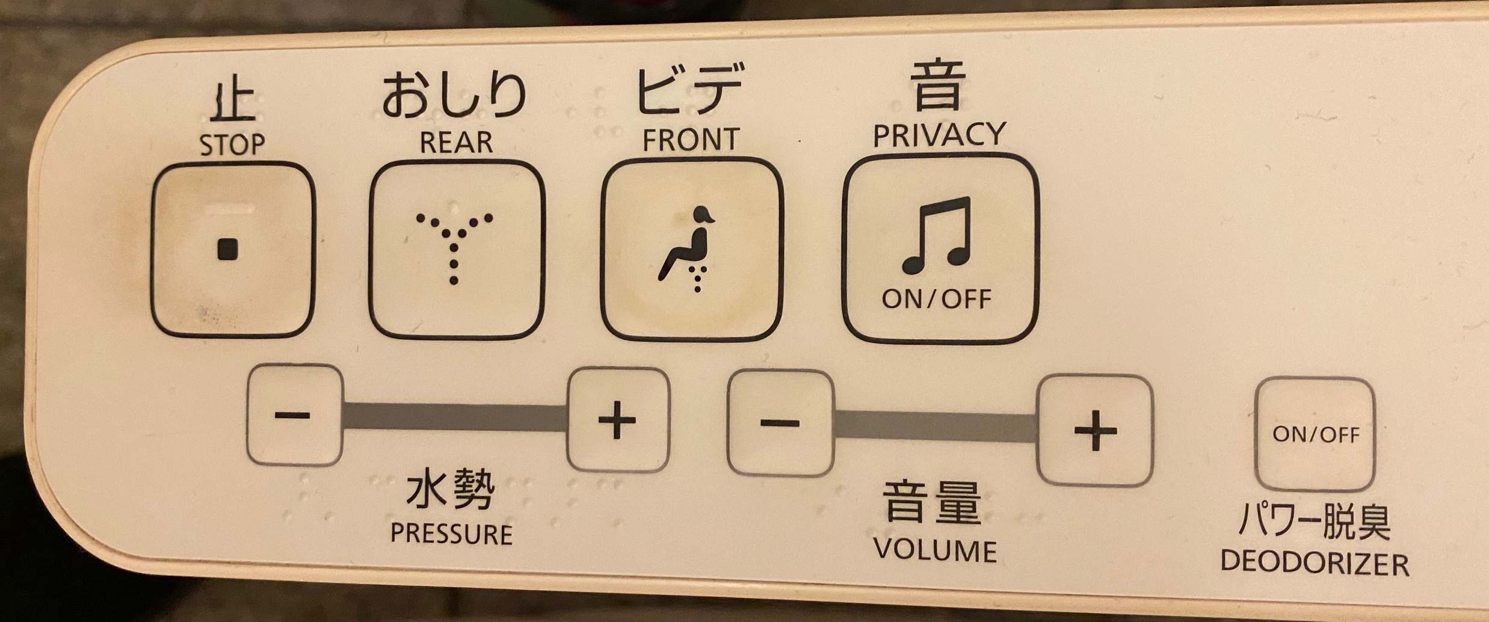
こ
れ
な
に
？
GO TO
PROMPT
(RESPONSE)
Start Timer

Slide 73
トイレの
操作（そうさ）
ボタン

